Slide 1
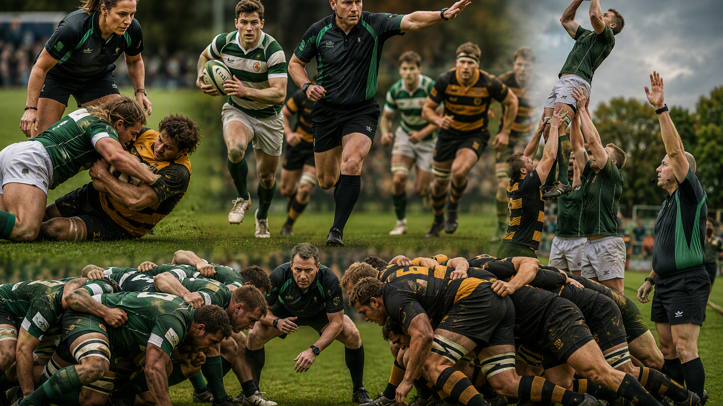
YOUR REFEREEING
SEASON
4 PRIORITIES. 4 PROMPTS.
A facilitated individual development planning workshop
75 MINUTES
REFEREE-LED
Lee Fish | Season 2026/27
Notes:
FACILITATOR NOTES
TIME: 1 minute
Welcome the group. Say: “Tonight is not about completing a form. It is about identifying the few things that will genuinely improve your refereeing this season.”
Set the expectation that people will do most of the talking and leave with a usable plan.
[Sources]
- Visual on this slide was generated with Microsoft Copilot.
[/Sources]

Slide 2
The destination
4 MIN
By the end, every referee leaves with a plan they can use on Saturday.
1 Diagnose
2 Choose
3 Compress
Use evidence, not vague feelings.
Identify the biggest opportunities.
Commit to only three or four priorities.
Make each one observable.
Reduce each priority to a one or two-word scorecard prompt.
TODAY’S OUTPUT
A full-season plan → four match-day cues
Example: Tackle Safety | Trends | Movement | Presence
Notes:
FACILITATOR NOTES
TIME: 4 minutes, cumulative 5
Explain the three-stage process. Ask for a show of hands: “Who currently has a development plan they could describe without looking at it?”
Do not debate answers yet. Use the response to establish the need for simplicity.

Slide 3
Why development plans fail
5 MIN
A plan that cannot influence behaviour is administration, not development.
Too broad
Too long
Too vague
Too passive
“Improve game management”
Seven to ten competing goals
No observable behaviour
Depends entirely on reviews
✕
✕
✕
✕
SHORT • PERSONAL • OBSERVABLE • PRACTISED
Notes:
FACILITATOR NOTES
TIME: 5 minutes, cumulative 10
Ask: “Which of these traps have you seen in your own plans?” Take three or four quick comments.
Make the distinction between an aspiration and a behaviour. “Be more confident” is an aspiration. “Close the conversation after a decision” is an observable behaviour.

Slide 4
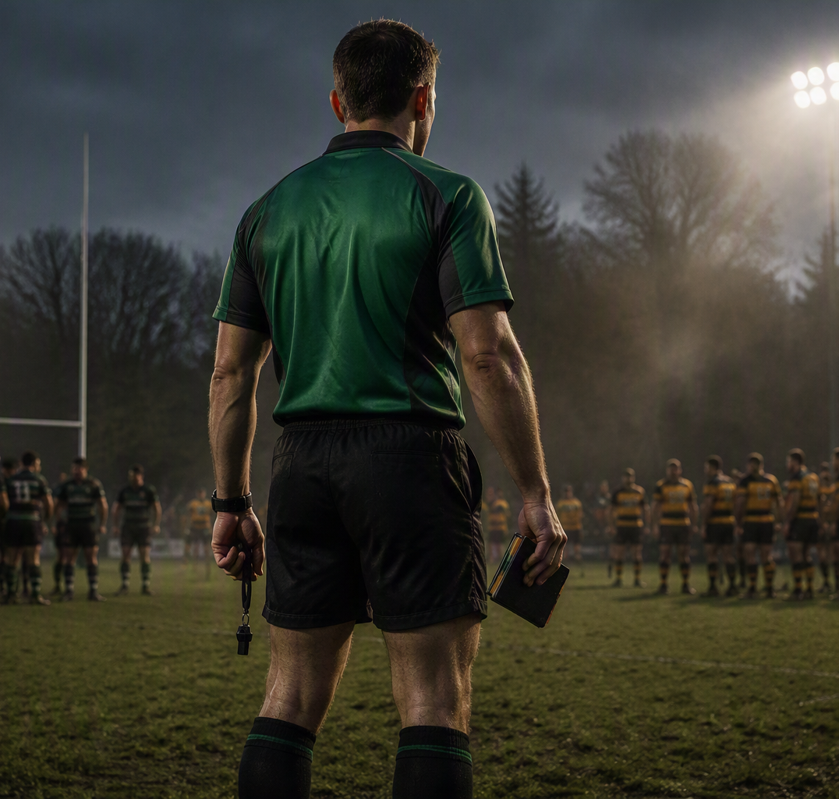
What does good look like?
8 MIN
Start with performance, not paperwork.
GROUPS OF 3–4
Think of an excellent referee.
What do they consistently do that makes the game better?
• 4 minutes discussion
• Agree your top three behaviours
• 30-second share-back per group
Listen for behaviours, not personality traits.
Notes:
FACILITATOR NOTES
TIME: 8 minutes, cumulative 18
Set groups of three or four. Give four minutes for discussion, then take 30-second reports. Capture their words on a flipchart.
If answers are traits such as “calm” or “confident”, ask: “What would I actually see or hear?”
Cluster contributions under decision-making, movement, communication, safety, set-piece and preparation.
[Sources]
- Visual on this slide was generated with Microsoft Copilot.
[/Sources]

Slide 5
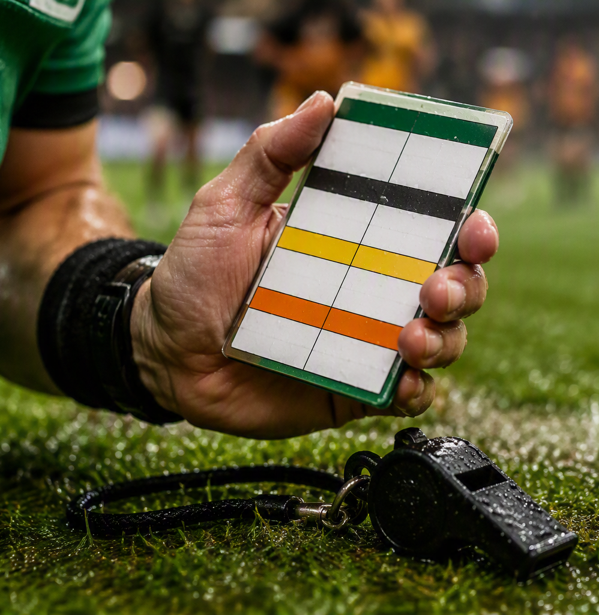
Use the frameworks as lenses
7 MIN
The framework should sharpen your plan, not write it for you.
SAFETY
Safe contest
SPEED
Continuity
SPACE
Opportunity
SCRUM
Equity
LINEOUT + MAUL
Fair transition
RMDE + review forms
look for evidence in the referee’s match-day behaviours and impact.
Notes:
FACILITATOR NOTES
TIME: 7 minutes, cumulative 25
Briefly connect the group’s “good referee” behaviours to the Big 5 and the RFU match-day/review language.
Stress that not every referee needs one goal in every Big 5 area. The lenses help diagnose impact and avoid blind spots.
Also explain that Form 3 is a useful stretch reference for those targeting National League Match Officials Team standards, but it should not distort the needs of referees working below that level.
[Sources]
- Visual on this slide was generated with Microsoft Copilot.
- RFU Learning Hub: https://www.englandrugby.com/run/refereeing/learning-hub
- RFU RMDE guidance: https://rfu.widen.net/s/kvtcr8c5nb/referee-match-day-experience-guidance-v1.7--10032026
[/Sources]

Slide 6
The five ways to change
10 MIN
Judge each area through a practical action lens.
MORE
DIFFERENTLY
BETTER
LESS
THE SAME
What useful behaviour should I do more often?
What should I approach in a different way?
What existing behaviour needs higher quality?
What gets in the way and should reduce?
What strength must I deliberately retain?
Use evidence from your last 6–10 matches. Write one possible change under each lens.
Notes:
FACILITATOR NOTES
TIME: 10 minutes, cumulative 35
Give seven minutes of quiet reflection. Ask participants to review their recent refereeing through five lenses: More, Differently, Better, Less and The Same.
“The Same” matters because development should preserve strengths, not accidentally remove them.
For the final three minutes, ask them to circle the changes supported by the strongest match evidence.

Slide 7
Peer challenge: find the leverage point
12 MIN
Pairs. Listen first, then test the evidence.
01
What do you do really well?
6 + 6
minutes
02
What one change would most improve your refereeing?
Referee A speaks
Referee B challenges
Then swap.
03
What recurring habit would frustrate an honest observer?
Notes:
FACILITATOR NOTES
TIME: 12 minutes, cumulative 47
Pair people who do not normally work together if possible. Six minutes each.
The listener’s role is not to solve the problem. The listener tests specificity using: “When does that happen?”, “What is the impact?” and “What would better look like?”
Call time firmly at six minutes and make them swap.

Slide 8
Choose only three or four
6 MIN
Prioritise changes by their contribution to the game.
GAME
PRIORITIES
How will this make the match safer, fairer or better to play?
Which Big 5 or personal performance priority does it serve?
ACTION
EVIDENCE
Will I do more, differently, better, less or the same?
How will I recognise a change in performance?
If everything is a priority, nothing is. Keep only 3 or 4.
Notes:
FACILITATOR NOTES
TIME: 6 minutes, cumulative 53
Ask everyone to shortlist five possible changes, then test each against four questions: connection to the game, contribution to priorities, the type of behavioural change, and evidence.
They must delete at least one. If a proposed change has no clear benefit for the game, it should not survive.

Slide 9
Build each priority into a working plan
9 MIN
Make the connection from behaviour to game impact explicit.
PRIORITY
CHANGE LENS
CONNECTION TO GAME
ACTION
EVIDENCE
Trends
Better
Recognise go forward
Reward positivity
Track team / offence / zone
Warnings and sanctions earlier, reduction in PKs
Movement
More
Better presence, accuracy and prevention
Two positioning cues per match, 5-7 o'clock, try line work
Video shows earlier arrival
Presence
Differently
Trust and credibility
Rehearse and use shorter captain messages
Fewer repeated conversations
Test: can you explain how the change improves the players’ match-day experience?
Notes:
FACILITATOR NOTES
TIME: 9 minutes, cumulative 62
Give six minutes to draft the rows and three minutes for a partner check.
Each priority must state the type of change and its connection to the game. Ask: “What will players, teams or fellow officials experience differently if this improves?”
The examples are illustrative, not prescribed answers.

Slide 10
Pressure-test the plan
4 MIN
Three questions. Four minutes. Ruthless editing.
GAME?
PRIORITY?
CHANGE?
Is the benefit to
the game clear?
Does it serve a real development priority?
Is it More, Differently, Better, Less or The Same?
👁
↻
✓
If the answer is “no”, rewrite it now.
Notes:
FACILITATOR NOTES
TIME: 4 minutes, cumulative 66
In pairs, read each priority aloud and answer the three tests. Rewrite immediately if any answer is no.
If the connection to the game or priority is weak, rewrite or remove it. Confirm the intended change through the five action lenses.

Slide 11
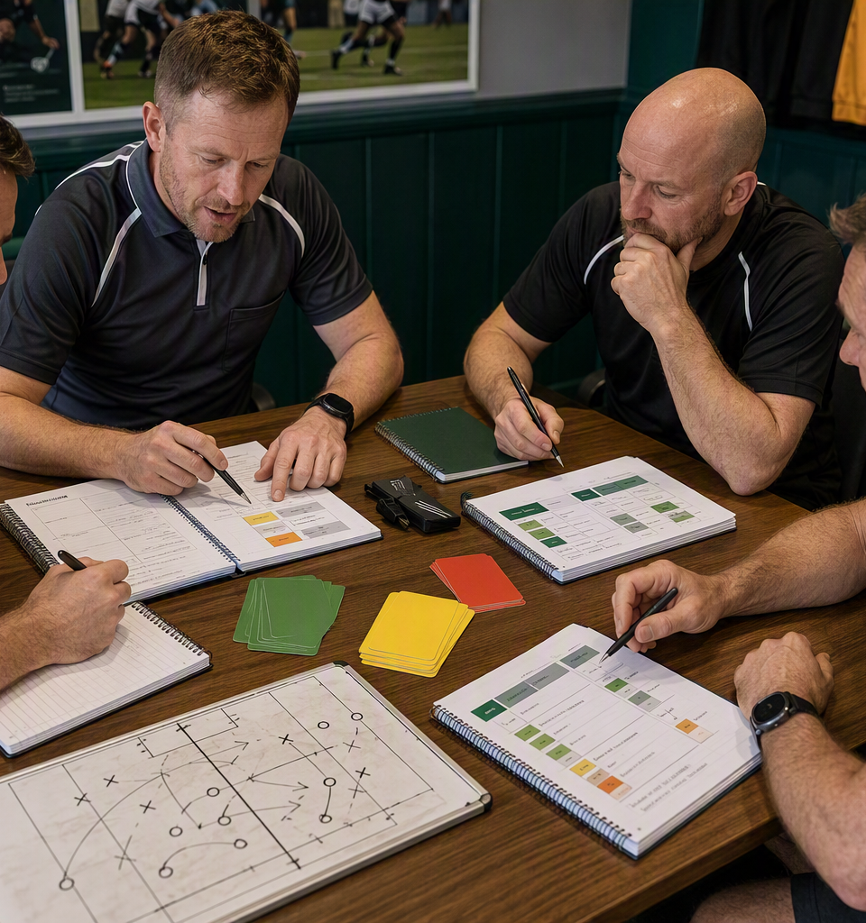
Compress it for match day
5 MIN
The plan lives in detail. The scorecard carries the cue.
FULL PRIORITY
Recognise repeated infringements and escalate earlier
SCORECARD CUE
TRENDS
one or two words • instantly meaningful • action-triggering
Possible cues: Safety | Arrival | Flow | Space | Scrum | Trends | Presence | Teamwork
Notes:
FACILITATOR NOTES
TIME: 5 minutes, cumulative 71
Each person now compresses every full priority into a one or two-word cue.
The cue does not need to make sense to anyone else. It must trigger the right behaviour for that referee.
Have them write the final cues where they will actually see them: scorecard, referee wallet, notes app or kit bag.
[Sources]
- Visual on this slide was generated with Microsoft Copilot.
[/Sources]

Slide 12
Commit and share
3 MIN
Say it aloud. Make it real.
MY FOUR
SAFETY
One sentence each:
TRENDS
“My priorities are…
The one that matters most is…
I will start by…”
MOVEMENT
PRESENCE
Buddy check-in after 4–6 matches
Notes:
FACILITATOR NOTES
TIME: 3 minutes, cumulative 74
Go round the room rapidly. Each referee shares their cues and names the most important first action. Keep it to one sentence each.
Ask pairs to agree a check-in after four to six matches. The purpose is to review evidence and adjust, not to judge one another.

Slide 13
THE FORM IS NOT
THE OUTCOME.
Better refereeing is.
Simple enough to remember.
Focused enough to act on.
Honest enough to make a difference.
Good luck this season.
Notes:
FACILITATOR NOTES
TIME: 1 minute, cumulative 75
Close with: “The objective is not to complete a form. The objective is to become a better referee. Keep the detailed plan for development conversations and keep the four cues with you every Saturday.”

Slide 14
Appendix: individual planning sheet
HANDOUT
Print or send digitally. One row per priority.
PRIORITY
WHY IT MATTERS
DELIBERATE ACTION
EVIDENCE
SCORECARD CUE
Review date: ____________________ Buddy / coach: ____________________
Notes:
FACILITATOR NOTES
Optional handout slide. Print as one slide per page. The four rows deliberately enforce prioritisation.

Slide 15
Appendix: prompt bank
REFERENCE
Use only if someone is stuck. These are cues, not prescribed goals.
GAME IMPACT
SEEING
MANAGING
Safety • Flow • Space • Equity
Arrival • Scan • Width • Depth
Trends • Presence • Boundaries • Captains
SET PIECE
SELF
TEAM
Scrum • Stability • Lineout • Maul
Calm • Clarity • Reset • Prepare
Teamwork • ARs • Briefing • Review
A cue is useful only if it triggers a specific behaviour for that referee.
Notes:
FACILITATOR NOTES
Optional reference slide. Avoid showing this before participants generate their own language, otherwise the room may copy rather than think.

